Slide 1
On-line survey
Supplemental material:
Toward a framework for comparing functionalities of multimorbidity clinical decision support: A literature-based feature set and benchmark cases

Slide 2
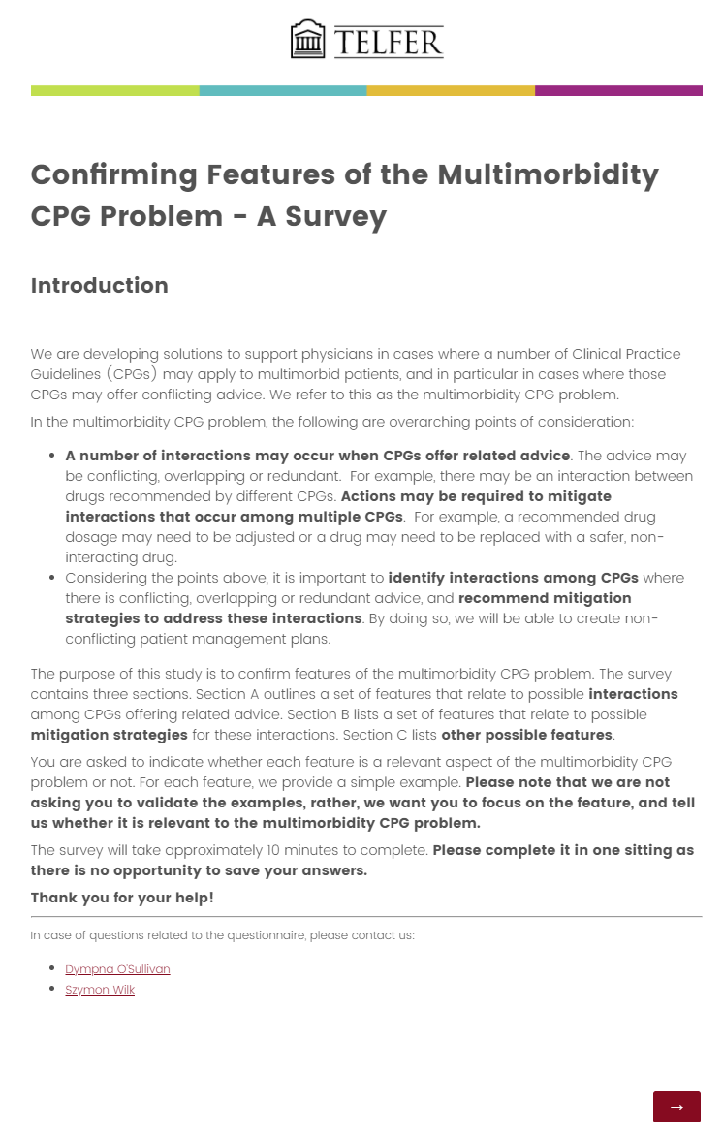
Introduction

Slide 3
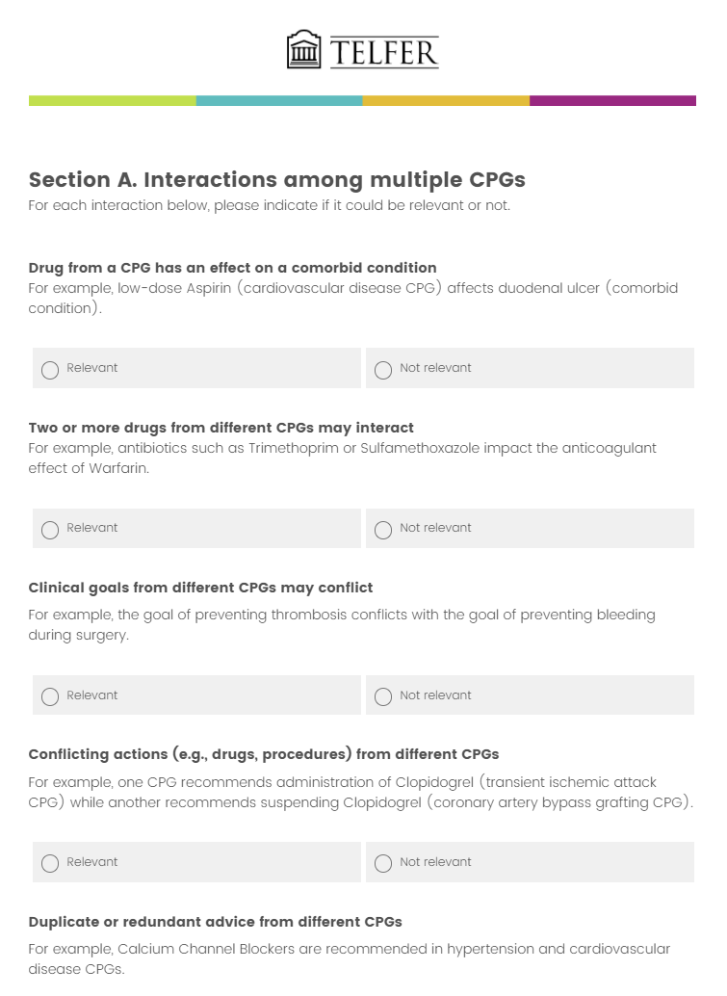
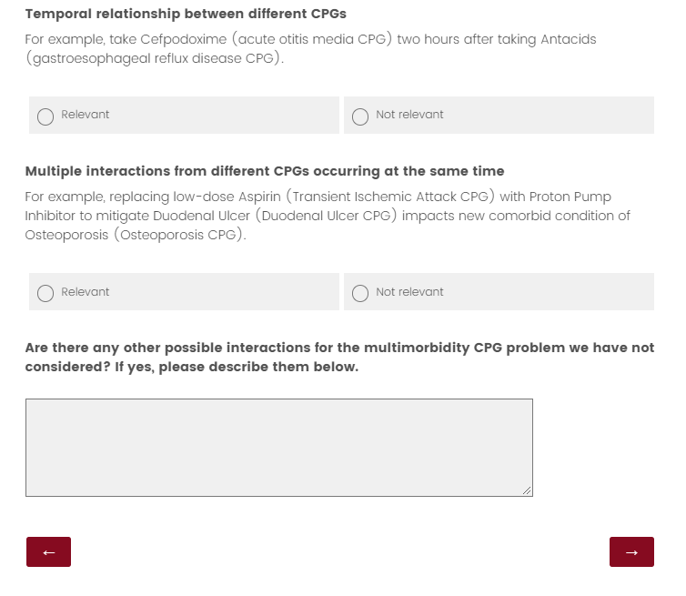
Features related to adverse interactions

Slide 4
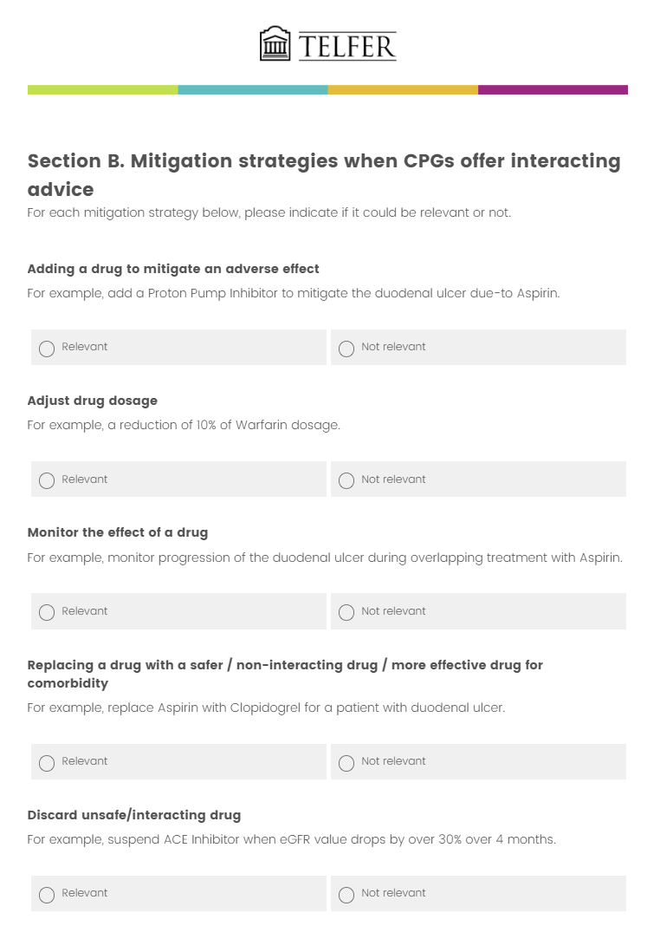
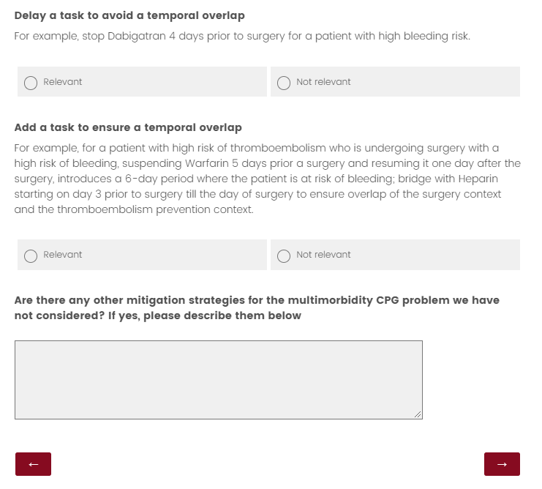
Features related to mitigation strategies

Slide 5
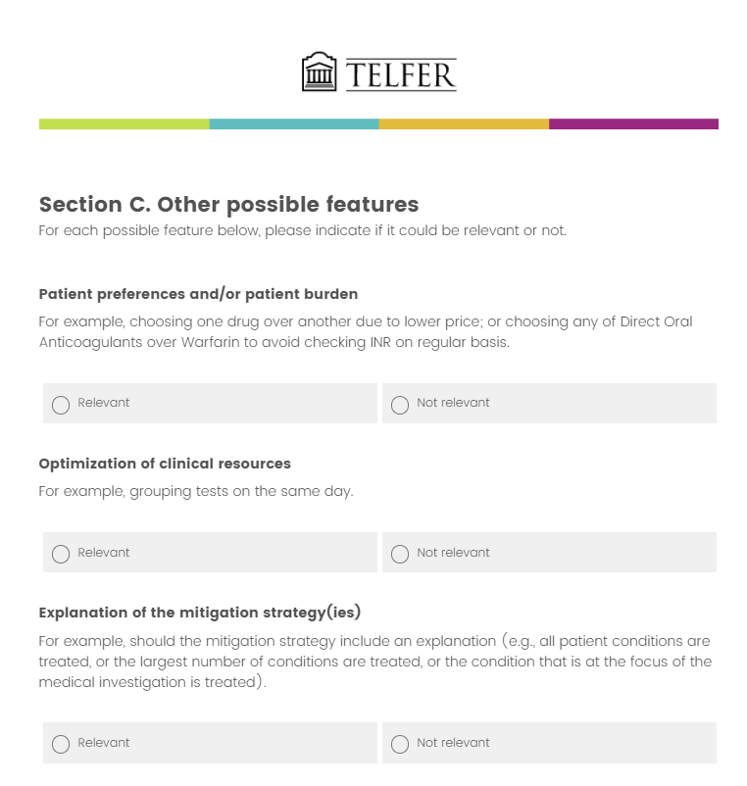
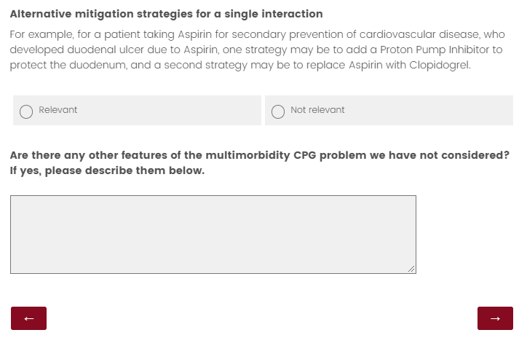
Other possible features

